Slide 1
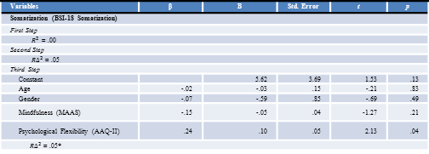
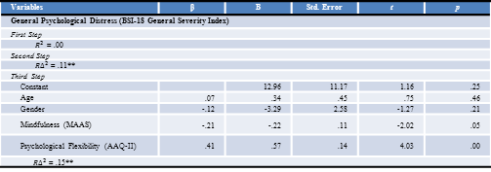
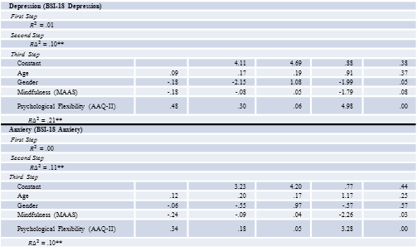
Does Mindfulness and Psychological Flexibility predict Somatization, Depression, Anxiety and General Psychological Distress in a Non-clinical Asian American College Sample? Amar Mandavia, Dr. Akihiko Masuda & Dr. Erin Tully Georgia State University
Background
Methods (cont.)
Results (cont.)
Asian Americans experience a range of psychological stuggles, including depression, anxiety and emotional distress (Young, Fang & Zisook 2010; Okazaki 1997; Masuda, Wendell, Chou & Feinstein 2010)
Weisz, Rothbaum and Blackburn (1984) have shown that in order to understand the psychological health of Asians, the research needs to look at how they regulate emotions and behaviors.
Mindfulness is a regulation process that is defined as awareness and attention to the present events and experiences through a non-judgmental perspective (Black, 2011).
Previous research has shown that there is negatively correlated relationship between mindfulness and psychological distress (Coffey & Hartman, 2008).
Psychological Flexibility is often defined as a regulation process in which the present moment is experienced without avoidance and judgment while engaging in behavior that reflects one’s personal value (Masuda & Tully, 2012; Hayes et al., 2006)
Kashdan and Rottenberg (2010) suggests that increased psychological flexibility is correlated with better mental health.
To date, there is no research investigating the role of psychological flexibility and mindfulness simultaneously on different facets of distress.
The present study examined the relations among mindfulness, psychological flexibility, and a various forms of psychological distress (i.e., general distress, somatization, depression, and anxiety) in Asian American undergraduate students.
We hypothesized that mindfulness and psychological flexibility would be uniquely and separately associated with various forms of psychological distress.
Acceptance and Action Questionnaire – II (AAQ-II; Bond et al., 2011). A measure of Psychological inflexibility
Procedures: Anonymous web-based survey
Data Analysis
A series of hierarchal regressions analysis were conducted to investigate the relationships between mindfulness, psychological flexibility, and distress separately by distress variables.
The first step includes age and gender as covariates.
The second step adds mindfulness to the age and gender covariates .
The third step includes psychological flexibility.
Variables | β | B | Std. Error | t | p
Somatization (BSI-18 Somatization)
First Step
$R^{2}$ = .00
Second Step
${R∆}^{2}$ = .05
Third Step
Constant |  | 5.62 | 3.69 | 1.53 | .13
Age | -.02 | -.03 | .15 | -.21 | .83
Gender | -.07 | -.59 | .85 | -.69 | .49
Mindfulness (MAAS) | -.15 | -.05 | .04 | -1.27 | .21
Psychological Flexibility (AAQ-II) | .24 | .10 | .05 | 2.13 | .04
${R∆}^{2}$ = .05*
Notes: N=87, * p<0.05, ** p<0.01, MAAS = Mindfulness Attention Awareness Scale; AAQ-II = Acceptance and Action Questionnaire; BSI-18 = Brief Symptom Inventory- 18 item
Table 2
Means, Standard Deviations and Zero-Order Relations between all Variables
Results
 |  | 1 | 2 | 3 | 4 | 5 | 6 | 7 | 8
1 | Mindfulness (MAAS ) | --
2 | Psychological Flexibility (AAQ II ) | -.32** | --
3 | BSI-18 total | -.31** | .46** | --
4 | Somatization (BSI-18 Somatization) | -.22* | .28** | .86** | --
5 | Depression (BSI-18 Depression) | -.30** | .51** | .93** | .68** | --
6 | Anxiety (BSI-18 Anxiety) | -.31** | .40** | .92** | .71** | .78** | --
7 | Gender | -.05 | .11 | -.06 | -.04 | -.12 | -.00 | --
8 | Age | .27* | -.06 | -.01 | -.08 | .00 | .03 | .04 | --
 | M | 56.32 | 22.76 | 14.89 | 3.74 | 6.08 | 5.07 | 1.70 | 19.76
 | SD | 11.99 | 8.80 | 12.40 | 3.72 | 5.44 | 4.54 | .46 | 2.71
Table 1
Regression Analyses to examining the role of Mindfulness and Psychological Flexibility on various Psychological Distresses
Variables | β | B | Std. Error | t | p
General Psychological Distress (BSI-18 General Severity Index)
First Step
$R^{2}$ = .00
Second Step
${R∆}^{2}$ = .11**
Third Step
Constant |  | 12.96 | 11.17 | 1.16 | .25
Age | .07 | .34 | .45 | .75 | .46
Gender | -.12 | -3.29 | 2.58 | -1.27 | .21
Mindfulness (MAAS) | -.21 | -.22 | .11 | -2.02 | .05
Psychological Flexibility (AAQ-II) | .41 | .57 | .14 | 4.03 | .00
${R∆}^{2}$ = .15**
Notes: N=87, * p<0.05, ** p<0.01, MAAS = Mindfulness Attention Awareness Scale; AAQ-II = Acceptance and Action Questionnaire; BSI-18 = Brief Symptom Inventory- 18 item
Depression (BSI-18 Depression)
First Step
$R^{2}$ = .01
Second Step
${R∆}^{2}$ = .10**
Third Step
Constant |  | 4.11 | 4.69 | .88 | .38
Age | .09 | .17 | .19 | .91 | .37
Gender | -.18 | -2.15 | 1.08 | -1.99 | .05
Mindfulness (MAAS) | -.18 | -.08 | .05 | -1.79 | .08
Psychological Flexibility (AAQ-II) | .48 | .30 | .06 | 4.98 | .00
${R∆}^{2}$ = .21**
Anxiety (BSI-18 Anxiety)
First Step
$R^{2}$ = .00
Second Step
${R∆}^{2}$ = .11**
Third Step
Constant |  | 3.23 | 4.20 | .77 | .44
Age | .12 | .20 | .17 | 1.17 | .25
Gender | -.06 | -.55 | .97 | -.57 | .57
Mindfulness (MAAS) | -.24 | -.09 | .04 | -2.26 | .03
Psychological Flexibility (AAQ-II) | .34 | .18 | .05 | 3.28 | .00
${R∆}^{2}$ = .10**
Discussion
Methods
Results of regression analyses revealed that Mindfulness and Psychological inflexibility were significantly and uniquely associated with depression, anxiety, and general psychological distress in Asian Americans.
Contrary to our hypothesis, psychological flexibility, but not mindfulness, was uniquely associated with somatization.
Psychological inflexibility accounted for unique variance in all measures of distress.
These findings suggest that psychological flexibility and mindfulness are useful concepts for understanding various forms of distresses experienced by Asian American students.
Participants
87 Asian American College students (23% Indian, 20% Korean, 15% Vietnamese, 5% Pakistani, 3% Cambodian, 15% Others)
M Age = 19.76 (SD= 2.71)
Male = 26, Female = 61
Measures
Brief Symptom Inventory- 18 (BSI-18; Derogatis, 2001). A measure of psychological distress based on measures of depressive, anxious and somatic symptoms .
Mindful Attention Awareness Scale (MAAS; Brown & Ryan, 2003). A measure of mindlessness.

